Slide 1
Teaching Reading Strategies to Middle School Students
For Fiction, Nonfiction,
and Digital Sources
Julie Rohan
Nancy Brown
Vicki Keller

Slide 2
“With hocked gems financing him, he defied all scornful laughter that tried to prevent his scheme. ‘Your eyes deceive’, they said. ‘It is like a table, not an egg.’ Now three sturdy sisters sought truth. As they forged along, often over turbulent peaks and valleys, their days became weeks as many doubters spread fearful rumors about the edge. At last from nowhere, winged creatures appeared, signifying the journey’s end.”
--Christopher Columbus Discovering America

Slide 3
Seven Key Reading Strategies
Activating Background Knowledge
Questioning
Determining Important Ideas
Monitoring and Repairing Comprehension
Drawing Inferences
Synthesizing Information
Visualizing
Notes:
These seven key reading strategies were explained by Stephanie Harvey and were based on the research of P. David Pearson. They can be applied to a variety of texts from fiction to nonfiction. Throughout this presentation, we will share some ideas with you about how to teach the strategies to students. We’ll explain them in more detail as we demonstrate them.

Slide 4
Seven Key Reading Strategies
All are useful, but most effective when used in combination.
Good readers use them flexibly and call them into action when needed.
Effective instruction is the key to success!
Explaining
Modeling
Encouraging
Notes:
These seven key reading strategies were explained by Stephanie Harvey and were based on the research of P. David Pearson. They can be applied to a variety of texts from fiction to nonfiction. Throughout this presentation, we will share some ideas with you about how to teach the strategies to students. We’ll explain them in more detail as we demonstrate them.

Slide 5
Ways to Encourage Use
Introduce strategies early in the year and reinforce use throughout the year.
Display the strategies in the room.
Regularly model how to use the strategies during read aloud and guided reading.
Encourage use during independent reading.
Help students make good reading choices.
Explore different methods and activities for students to practice use.
Notes:
These seven key reading strategies were explained by Stephanie Harvey and were based on the research of P. David Pearson. They can be applied to a variety of texts from fiction to nonfiction. Throughout this presentation, we will share some ideas with you about how to teach the strategies to students. We’ll explain them in more detail as we demonstrate them.

Slide 6
Strategies for Fiction

Slide 7
Sticky Note Method
Fiction Reading
Questioning
Predicting
Plot Points
Summarizing
Making Connections
Notes:
These seven key reading strategies were explained by Stephanie Harvey and were based on the research of P. David Pearson. They can be applied to a variety of texts from fiction to nonfiction. Throughout this presentation, we will share some ideas with you about how to teach the strategies to students. We’ll explain them in more detail as we demonstrate them.

Slide 8
Strategies for Non-Fiction

Slide 9
Applying the Strategies to Content Area Texts
Key Questions about teaching reading in the content areas
Why aren’t reading skills taught more often at the middle school level?
Do all students struggle with content area reading?
What is driving the renewed interest in teaching reading strategies?
Why is middle school a good time to focus on the teaching of reading skills?
What methods can teachers use to help students become more strategic readers?
Notes:
This part of the presentation will focus on teaching some of the seven reading strategies in content area classrooms such as social studies, math, and science classrooms. Let’s examine some key questions related to the topic.
Why aren’t reading skills taught more often at the middle school level? Content area teachers are content experts who have a passion for what they teach. However, they need to teach students how to learn. Students don’t have the years of background knowledge and subject vocabulary that the teachers possess. So, they need to be guided in how to use reading strategies to understand texts.
Do all students struggle with content area reading? All students can benefit from learning how to use reading strategies. Low-achieving students may benefit the most from strategy instruction, but good readers also struggle with difficult texts. Good readers are more likely to have developed reading strategies on their own, but they can always learn more techniques to help them comprehend content area material.
What is driving the renewed interest in teaching reading strategies? The standards movement is focusing attention on reading skills at the middle school and high school levels. Many assessments and standards are measuring reading and writing skills. This indicates that our educational system wants students who have the following skills as summarized by Marcia D’Arcangelo in her article “The Challenge of Content-Area Reading” : “We want students who can read information, make critical decisions about it, form their own opinions, and respond intelligently.”
Why is middle school a good time to focus on the teaching of reading skills? Shouldn’t students have already learned these skills in elementary school? According to the National Institute of Mental Health, “Children’s cognitive ability increases during late childhood and early adolescence.” Middle school is a time when grade-level learning begins to focus less on process learning and more on subject-area knowledge. Teachers can use this period of cognitive growth to help students improve their basic literacy skills as well as their academic learning.
What methods can teachers use to help students become more strategic readers?
Teaching students the seven reading strategies presented in this workshop is one way to help students become more strategic readers.

Slide 10
Activate Background Knowledge
Pre-reading strategy
Set a purpose for reading
Use some teaching techniques such as:
K-W-L
Anticipation Guide
Lecture, video, or other visual
Previewing the text
Notes:
The first reading skill I will focus on is Activating Background Knowledge. This is a pre-reading strategy, because students need to spend some time looking over the text before beginning the reading process.
Setting a purpose for reading helps students think consciously about why they are about to read a particular text. For example, soon you will be working with a chapter from a geography textbook entitled, “Peru”. The geography teacher might set the purpose by telling students that she would like them to read this chapter for the purpose of noting similarities and differences between Peru and other countries in South America.
There are many teaching techniques that content area teachers can use to help students activate background knowledge.
*K-W-L stands for Know-Want to Know- and Learned. Students can fill out a chart sharing what they know about a topic before reading. They can also write some questions indicating what they’d like to learn. Finally, when they finish reading, they can tell what they learned.
*An Anticipation Guide consists of a series of statements to which students are asked to respond. It is a motivational teaching tool, because students use prediction, controversy, and activation of prior knowledge to get them interested in reading the assigned piece. When the teacher prepares an anticipation guide, he makes 5-10 accurate and inaccurate statements related to the content. Students can choose to agree or disagree with each statement. Then, students read the assigned text checking their initial reactions against information in the text. For example, if students were assigned to read an article entitled, “An Indian Father’s Plea”, one anticipation guide statement might be “Indian Education receives financial support from the federal government.”
*A teacher can use other methods to provide background material to students if she thinks they lack it. For example, a brief lecture might be given, a video clip might be shown, or another visual may develop interest in the students.
*Finally, I will present a short lesson on the strategy of teaching students to Preview text.

Slide 11
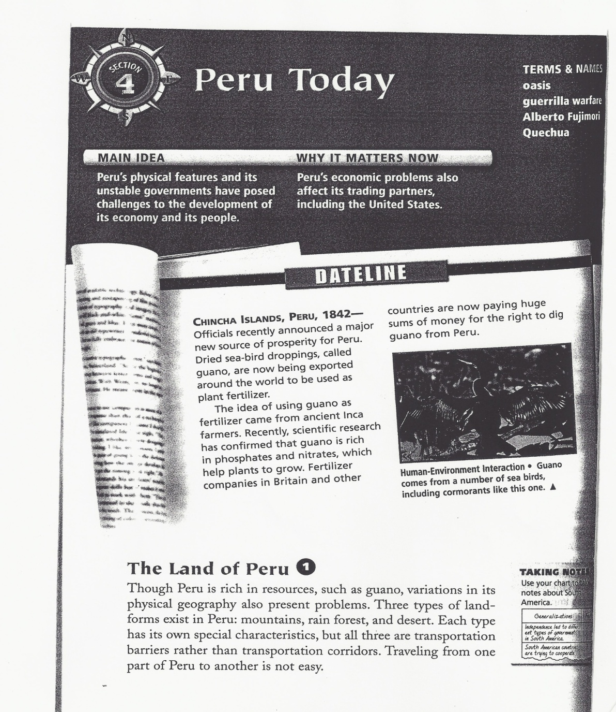
Previewing Text
Read the title
Skim the introduction
Read the headings and subheadings
Look at the visuals and captions
Scan for special terms
Skim the summary, if there is one
Skim the review questions.
Notes:
Often students want to rush into reading, so they can finish up their required work quickly. As content area teachers, you want to teach them the usefulness of previewing text before they read. Let’s follow the steps together of previewing this chapter from World Cultures and Geography on the country of Peru.
*First, we need to read the title. Students have already learned about the history of Peru, so this section of the chapter focuses on Peru today.
*Next, skim the introduction. In this case, we see a Main Idea and a statement “Why it matters now”.
*Now, read the headings and subheadings throughout the chapter section.
Let’s turn to more pages in the Peru chapter. Please turn to page 2.

Slide 12
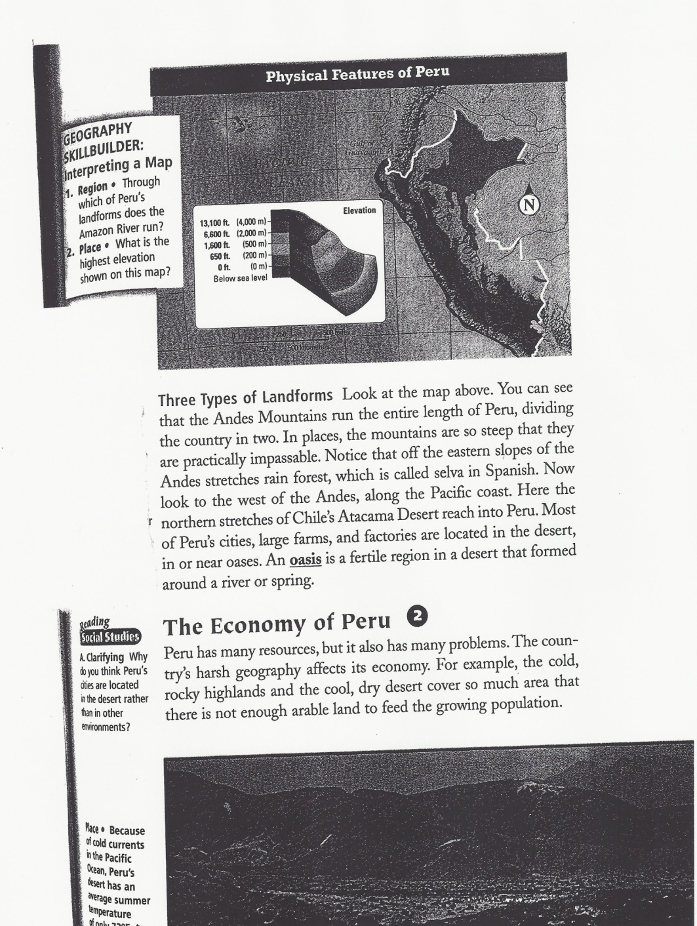
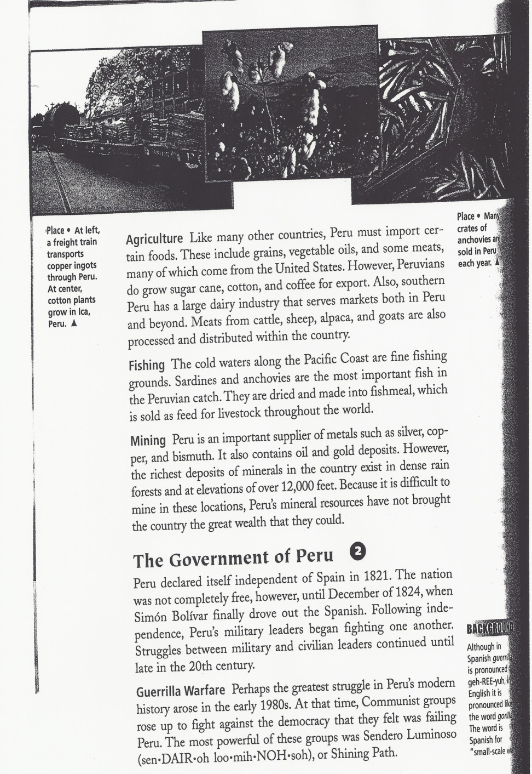
Notes:
Let’s look at the next two pages in the chapter, and skim the headings and the sub-headings. Can someone name more of these for us from these two pages? *
Next, we’ll look at the visuals on these pages and read the accompanying captions. *In the first visual, the map, we learn that the land of Peru varies by elevation. There is a low-lying desert area along the Pacific Coast, a mountainous area filled by the Andes Mountains, and a section of rainforest on the eastern slopes of the Andes Mountains. Take a few moments to examine the other visuals and captions on these pages.
After viewing the visuals, lets look for key terms. Usually, textbook publishers use bold print or underlining to make these terms more noticeable. Can anyone see a key term on one of these pages? *Right, oasis. Read the definition of that term.
Finally, finish up your previewing by examining the next two pages. Pay careful attention to the Section Assessment Review questions at the end of the piece. Those questions can alert the reader to key points included in the chapter.
Now that we’re finished previewing the text, I’d like you to put away the Peru chapter and get out a writing utensil. We’re going to take a little preview quiz to see how much you’ve learned. This doesn’t count for a grade, so don’t be nervous, it is just meant to show you how much your background knowledge has increased even before you’ve read the text.

Slide 13
Determining Important Ideas
Pre-reading, During reading, and After reading strategy
Words that signal importance: for example, in fact, in conclusion, but, therefore, such as
Textual features indicate importance: fonts, special effects like boldface print, italics
Expository Text Structure: cause/effect, problem/solution, question/answer, comparison/contrast, description, sequence
Finding Main Ideas in paragraphs: first and last sentences
Notes:
Let’s look at another strategy from the list of seven strategies that students can use to help them comprehend text. Determining Important ideas is a strategy that can be used in the pre-reading stage, during reading, and after reading. It involves decision making by the student. One of the best ways to teach this strategy is to model it with a think aloud.
Students also need to be taught how to use expository or nonfiction features to help them determine important ideas. Teaching students to recognize words that signal importance such as: for example, in conclusion, but… will help them realize that they need to pay close attention to the ideas that follow those words.
Students also need to be taught about textual features that alert readers to important information. Most of these are used often in school textbooks. The features might include special fonts, color print, bold print, italics, bullets, captions, and labels.
In fiction texts, students can readily recognize the sequential narrative framework of beginning, middle, end, and the elements of plot, setting, character, etc. However, students are less familiar with nonfiction text structure. If they learn to recognize and understand these structures, they will more likely comprehend what they are reading. Here are some of the most common expository text structures: Cause and effect, problem and solution, question and answer, comparison and contrast, description, and sequence. On your hand-out there are examples given of how to explain these text structures to students through sentences built around the term goose bumps. These ideas were shared by Stephanie Harvey in her book, Nonfiction Matters.
Another technique to demonstrate to students is how to find important ideas within paragraphs. Teach them that the first and last lines of a paragraph usually carry essential thoughts. For example, if you look at your Peru chapter again, you will notice the first sentence: Though Peru is rich in resources, such as guano, variations in its physical geography also present problems…. Then, look at the last sentence in the paragraph: Traveling from one part of Peru to another is not easy. From these two sentences one can learn that the physical geography of Peru impedes travel.

Slide 14
Strategies for Digital Literacy

Slide 15
Internet Research Challenges
Accessibility
Difficult Searches
Validity
Supervision
Distraction
Transient Websites
Typing Errors
Notes:
Let’s look at another strategy from the list of seven strategies that students can use to help them comprehend text. Determining Important ideas is a strategy that can be used in the pre-reading stage, during reading, and after reading. It involves decision making by the student. One of the best ways to teach this strategy is to model it with a think aloud.
Students also need to be taught how to use expository or nonfiction features to help them determine important ideas. Teaching students to recognize words that signal importance such as: for example, in conclusion, but… will help them realize that they need to pay close attention to the ideas that follow those words.
Students also need to be taught about textual features that alert readers to important information. Most of these are used often in school textbooks. The features might include special fonts, color print, bold print, italics, bullets, captions, and labels.
In fiction texts, students can readily recognize the sequential narrative framework of beginning, middle, end, and the elements of plot, setting, character, etc. However, students are less familiar with nonfiction text structure. If they learn to recognize and understand these structures, they will more likely comprehend what they are reading. Here are some of the most common expository text structures: Cause and effect, problem and solution, question and answer, comparison and contrast, description, and sequence. On your hand-out there are examples given of how to explain these text structures to students through sentences built around the term goose bumps. These ideas were shared by Stephanie Harvey in her book, Nonfiction Matters.
Another technique to demonstrate to students is how to find important ideas within paragraphs. Teach them that the first and last lines of a paragraph usually carry essential thoughts. For example, if you look at your Peru chapter again, you will notice the first sentence: Though Peru is rich in resources, such as guano, variations in its physical geography also present problems…. Then, look at the last sentence in the paragraph: Traveling from one part of Peru to another is not easy. From these two sentences one can learn that the physical geography of Peru impedes travel.

Slide 16
Research Guidelines
Choose the source that will best serve your needs and start there.
Skim and scan material before attempting to read it word for word.
Bookmark important information for later reference.
Ensure accuracy by rechecking information before reading it.
Notes:
Let’s look at another strategy from the list of seven strategies that students can use to help them comprehend text. Determining Important ideas is a strategy that can be used in the pre-reading stage, during reading, and after reading. It involves decision making by the student. One of the best ways to teach this strategy is to model it with a think aloud.
Students also need to be taught how to use expository or nonfiction features to help them determine important ideas. Teaching students to recognize words that signal importance such as: for example, in conclusion, but… will help them realize that they need to pay close attention to the ideas that follow those words.
Students also need to be taught about textual features that alert readers to important information. Most of these are used often in school textbooks. The features might include special fonts, color print, bold print, italics, bullets, captions, and labels.
In fiction texts, students can readily recognize the sequential narrative framework of beginning, middle, end, and the elements of plot, setting, character, etc. However, students are less familiar with nonfiction text structure. If they learn to recognize and understand these structures, they will more likely comprehend what they are reading. Here are some of the most common expository text structures: Cause and effect, problem and solution, question and answer, comparison and contrast, description, and sequence. On your hand-out there are examples given of how to explain these text structures to students through sentences built around the term goose bumps. These ideas were shared by Stephanie Harvey in her book, Nonfiction Matters.
Another technique to demonstrate to students is how to find important ideas within paragraphs. Teach them that the first and last lines of a paragraph usually carry essential thoughts. For example, if you look at your Peru chapter again, you will notice the first sentence: Though Peru is rich in resources, such as guano, variations in its physical geography also present problems…. Then, look at the last sentence in the paragraph: Traveling from one part of Peru to another is not easy. From these two sentences one can learn that the physical geography of Peru impedes travel.

Slide 17
Research Guidelines (cont.)
Record bibliographic information.
Use what you already know to help understand new information.
Use encyclopedias to begin research, not model writing.
Pay attention to publication or content dates.
Look for live or video presentations.
Notes:
Let’s look at another strategy from the list of seven strategies that students can use to help them comprehend text. Determining Important ideas is a strategy that can be used in the pre-reading stage, during reading, and after reading. It involves decision making by the student. One of the best ways to teach this strategy is to model it with a think aloud.
Students also need to be taught how to use expository or nonfiction features to help them determine important ideas. Teaching students to recognize words that signal importance such as: for example, in conclusion, but… will help them realize that they need to pay close attention to the ideas that follow those words.
Students also need to be taught about textual features that alert readers to important information. Most of these are used often in school textbooks. The features might include special fonts, color print, bold print, italics, bullets, captions, and labels.
In fiction texts, students can readily recognize the sequential narrative framework of beginning, middle, end, and the elements of plot, setting, character, etc. However, students are less familiar with nonfiction text structure. If they learn to recognize and understand these structures, they will more likely comprehend what they are reading. Here are some of the most common expository text structures: Cause and effect, problem and solution, question and answer, comparison and contrast, description, and sequence. On your hand-out there are examples given of how to explain these text structures to students through sentences built around the term goose bumps. These ideas were shared by Stephanie Harvey in her book, Nonfiction Matters.
Another technique to demonstrate to students is how to find important ideas within paragraphs. Teach them that the first and last lines of a paragraph usually carry essential thoughts. For example, if you look at your Peru chapter again, you will notice the first sentence: Though Peru is rich in resources, such as guano, variations in its physical geography also present problems…. Then, look at the last sentence in the paragraph: Traveling from one part of Peru to another is not easy. From these two sentences one can learn that the physical geography of Peru impedes travel.

Slide 18
5 Ways to Use the Internet to Teach Literature
Explore stories on the web.
Invite students to become authors on the web.
Participate in virtual book clubs.
Collaborate on Internet projects.
Add informational websites to your study of literature.
Notes:
Let’s look at another strategy from the list of seven strategies that students can use to help them comprehend text. Determining Important ideas is a strategy that can be used in the pre-reading stage, during reading, and after reading. It involves decision making by the student. One of the best ways to teach this strategy is to model it with a think aloud.
Students also need to be taught how to use expository or nonfiction features to help them determine important ideas. Teaching students to recognize words that signal importance such as: for example, in conclusion, but… will help them realize that they need to pay close attention to the ideas that follow those words.
Students also need to be taught about textual features that alert readers to important information. Most of these are used often in school textbooks. The features might include special fonts, color print, bold print, italics, bullets, captions, and labels.
In fiction texts, students can readily recognize the sequential narrative framework of beginning, middle, end, and the elements of plot, setting, character, etc. However, students are less familiar with nonfiction text structure. If they learn to recognize and understand these structures, they will more likely comprehend what they are reading. Here are some of the most common expository text structures: Cause and effect, problem and solution, question and answer, comparison and contrast, description, and sequence. On your hand-out there are examples given of how to explain these text structures to students through sentences built around the term goose bumps. These ideas were shared by Stephanie Harvey in her book, Nonfiction Matters.
Another technique to demonstrate to students is how to find important ideas within paragraphs. Teach them that the first and last lines of a paragraph usually carry essential thoughts. For example, if you look at your Peru chapter again, you will notice the first sentence: Though Peru is rich in resources, such as guano, variations in its physical geography also present problems…. Then, look at the last sentence in the paragraph: Traveling from one part of Peru to another is not easy. From these two sentences one can learn that the physical geography of Peru impedes travel.

Slide 19
Questions?

Slide 20
Thank You.
Julie Rohan
Nancy Brown
Vicki Keller

